Slide 1
Dynamic Model of Car
ECE5
J Eldon

Slide 2
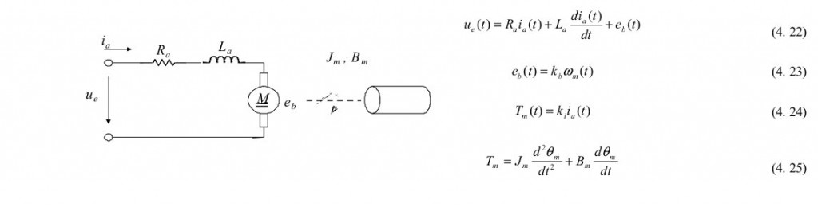
Electric Motor

Slide 3
Motor Equn Variables
torque K_i proportional to winding current
torque goes to drive + bearing friction

Slide 4
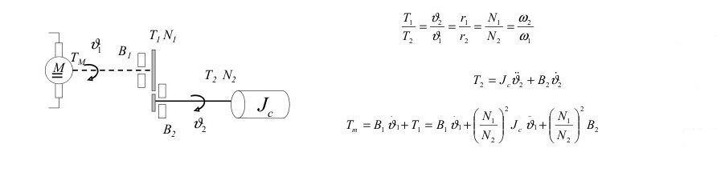
Motor W/ Geartrain

Slide 5
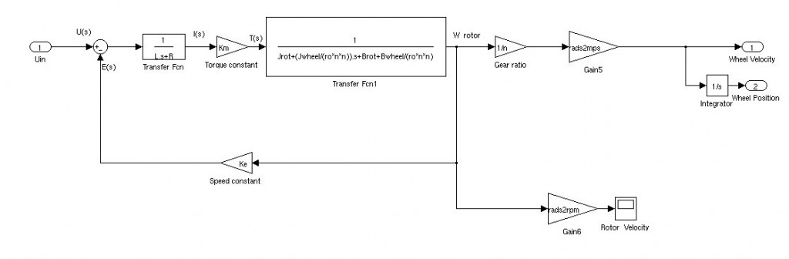
Simulink of Mechanicals

Slide 6
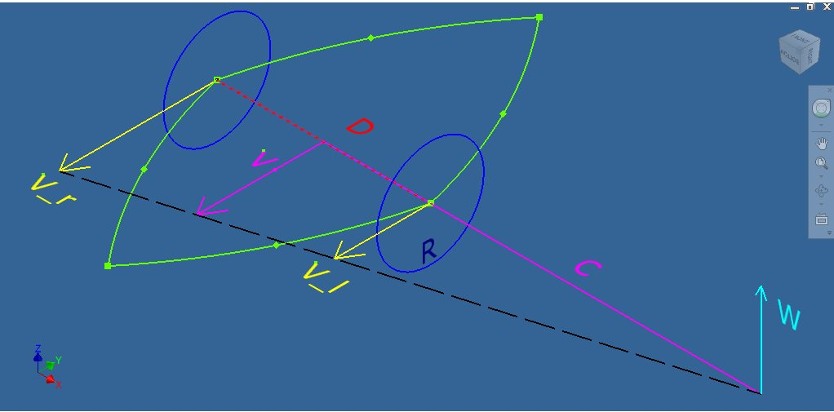
Differential v. Forward Drive

Slide 7
Variables
D = distance between wheels
V = robot linear speed
V_r, V_l = linear speed of right, left wheels, respectively
R = wheel radius
C = turning radius
W = rotational speed of robot

Slide 8
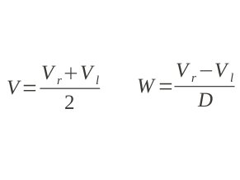
Linear & Rotational Speeds
V here is linear velocity (rotational*diameter)

Slide 9
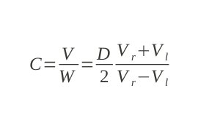
Turning Radius

Slide 10
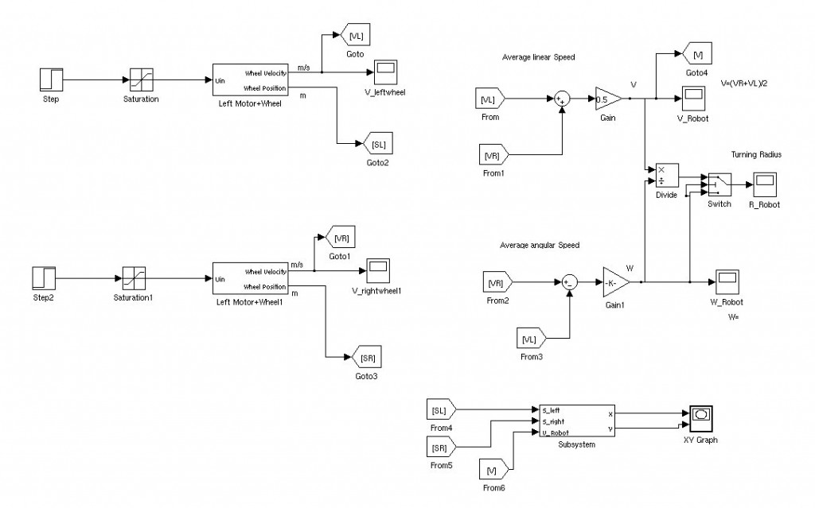
Simulink Model of Robot

Slide 11
Demo
1. run param_2224.m
2. run kinematic_model_pid.slx

